Slide 1
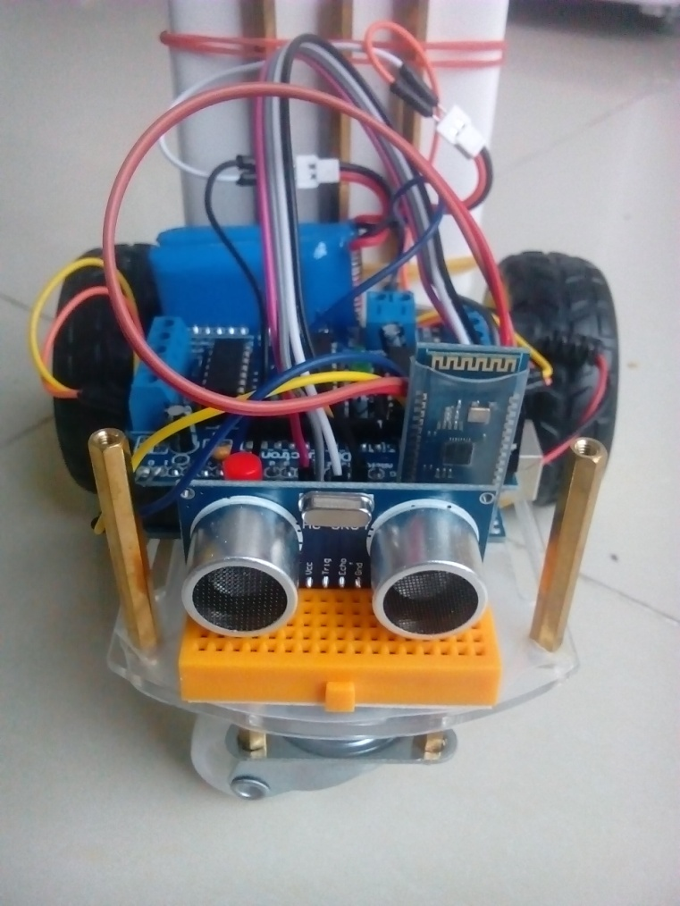
Aicar
for AI projects

Slide 2
outline
About Aicar
Aicar Hardware & Software Compents
Aicar startup
About Gym
Gym Environments
Gym startup

Slide 3
Aicar
In computer science, the field of AI research defines itself as the study of "intelligent agents": any device that perceives its environment and takes actions that maximize its chance of success at some goal.
Aicar is an inexpensive (~ 50￥) intelligent agent for carrying out research projects in artificial intelligence. With Aicar, you can test different AI algorithms and policies for conducting actions based on various sensors input.

Slide 4
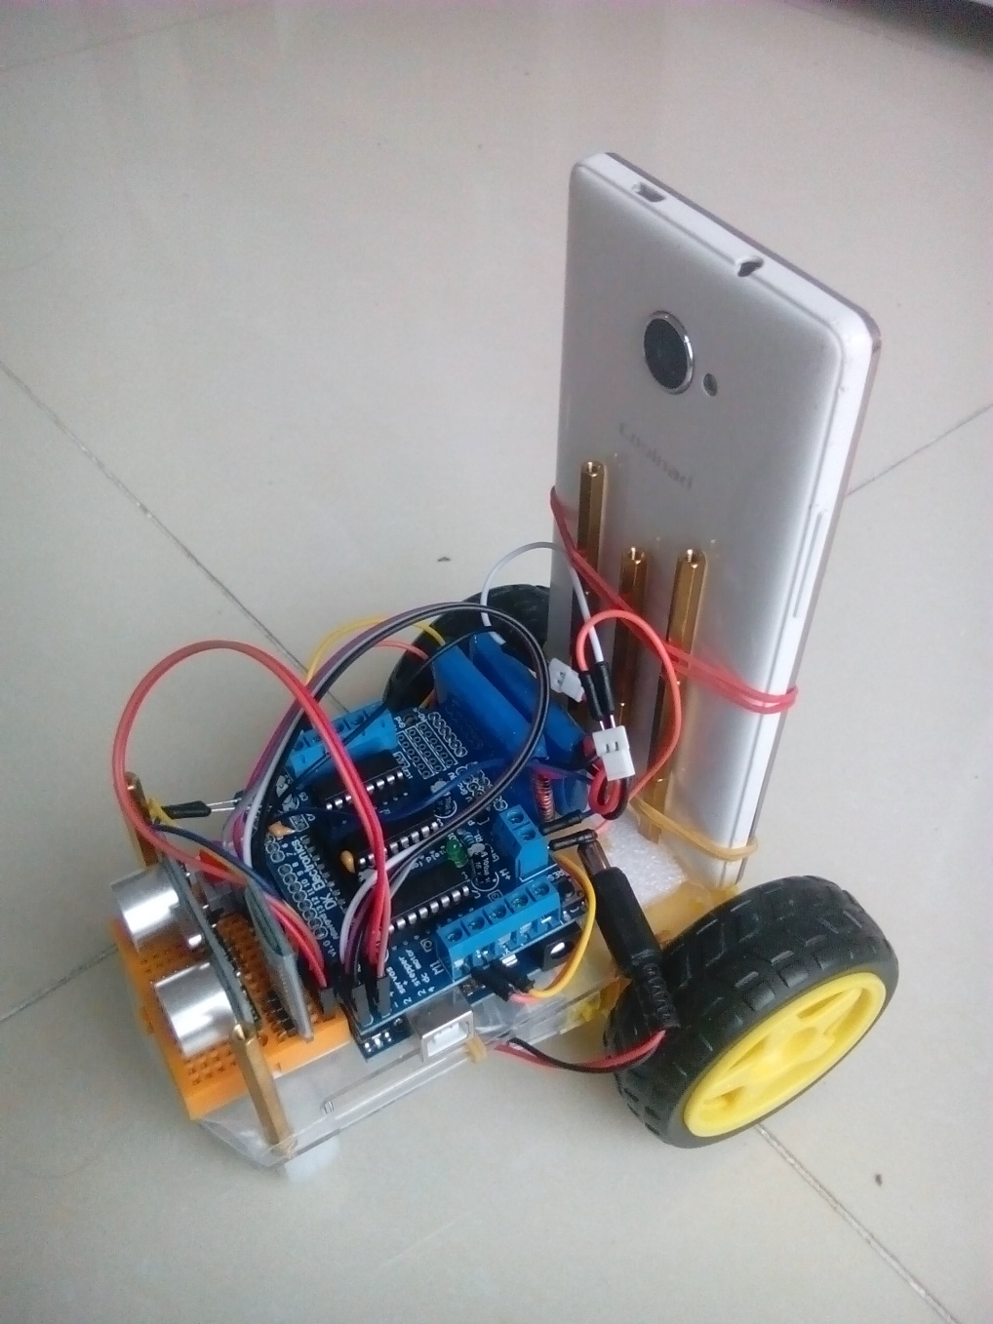
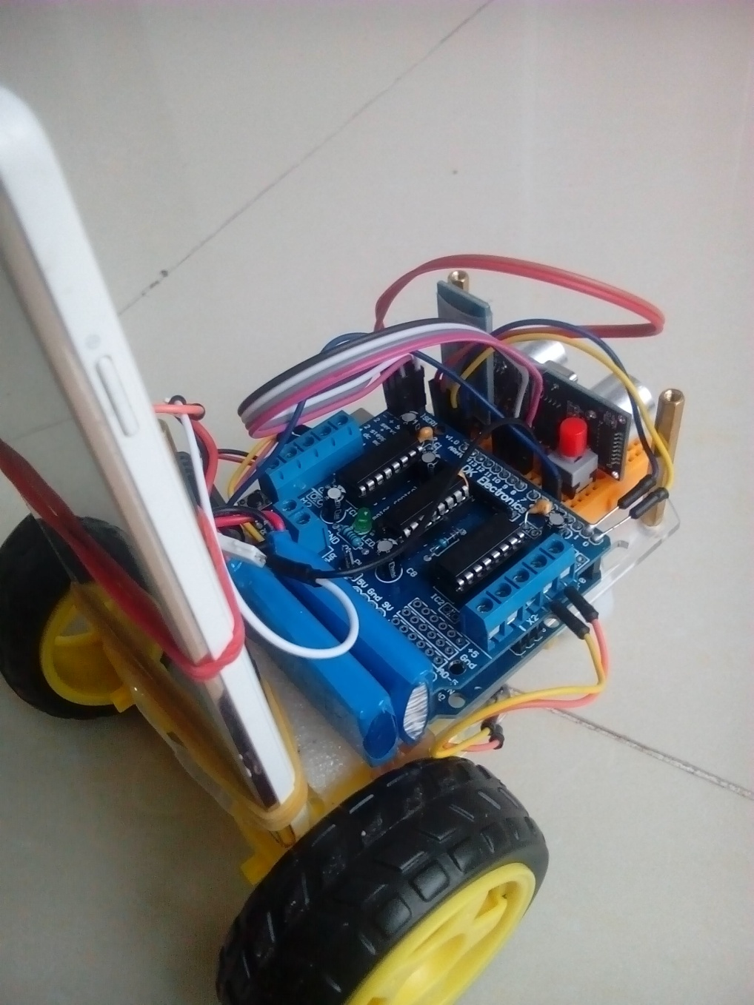
Aicar Hardware

Slide 5
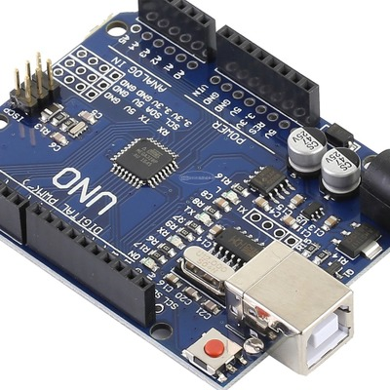
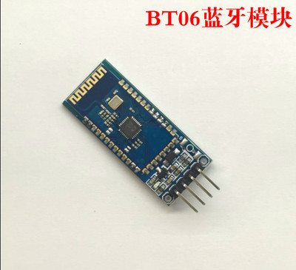
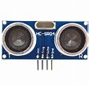
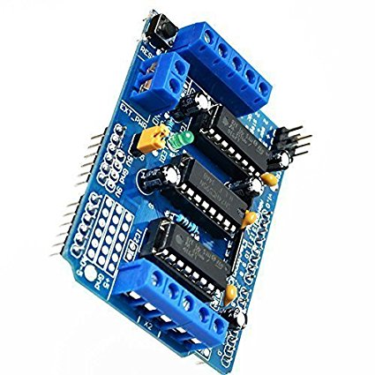
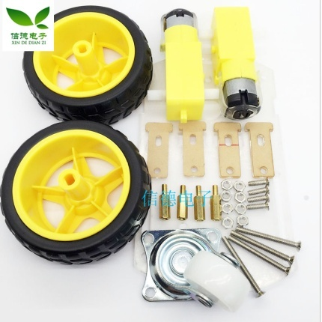
Hardware Components
Arduino UNO
BT06 Bluetooth
HC-SR04 Ultrasonic Distance Measuring
L293D Motor Drive Shield
2WD Smart Robot Car Chassis Kit
Notes:
an inexpensive two-wheeled differentially-steered robot based on the popular Arduino Uno compatible microcontrollers

Slide 6
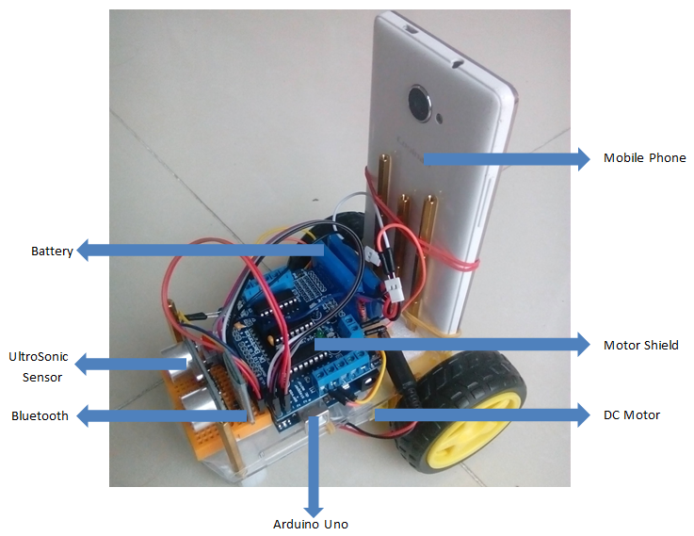
Aicar Components

Slide 7
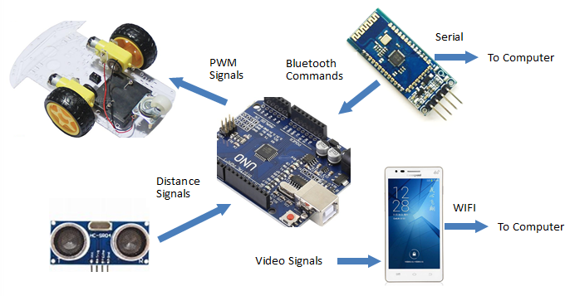
Aicar Information Flow

Slide 8
Components Price List
TABLE I COMPONENTS OF THE AICAR AUTONOMOUS VEHICLE PLATFORM
Component | Price(¥) | Price($) | Source
2WD Smart Robot Car Chassis Kit | 9 | 1.38 | Taobao.com
Arduino Uno Compatible(with USB cable) | 11.7 | 1.80 | Taobao.com
HC-SR04 Ultrasonic Sensor | 2.2 | 0.34 | Taobao.com
BT06 Bluetooth Module | 8.7 | 1.34 | Taobao.com
L293D Motor Drive Shield | 7.8 | 1.20 | Taobao.com
Model power battery(3.7V 780mAh) x2 | 20 | 3.08 | Taobao.com
Total Price | ¥ 59.4 | $ 9.14

Slide 9
Software Components
Video Capture Tools
DroidCam for Android
DroidCam Client for Win/Linux
Development
Arduino IDE (C/C++)
Matlab
Python

Slide 10
Functions
#include <AFMotor.h>
AF_DCMotor Rback_motor(4);
AF_DCMotor Lback_motor(1);
float RLRatio = 1.0;
int maxSpeed = 80;//最大速度
char getstr;//串口数据
int IntervalTime;//测距时间
int trig = 9;//sero1保留端口
int echo = 10;//sero2保留端口
int control=1;//0:人工控制;1:自动控制

Slide 11
Functions
void setup() {
// put your setup code here, to run once:
Serial.begin(9600);
Rback_motor.setSpeed(0);
Rback_motor.run(RELEASE);
Lback_motor.setSpeed(0);
Lback_motor.run(RELEASE);
delay(2000);
//超声波测距
pinMode(echo, INPUT);
pinMode(trig, OUTPUT);
}

Slide 12
Functions
void loop() {
getstr = Serial.read();
driver();
if(control==1){
ultrasonicCar();
}
}

Slide 13
Functions
void forward() {
Rback_motor.run(BACKWARD);
Lback_motor.run(BACKWARD);
Rback_motor.setSpeed(maxSpeed*RLRatio);
Lback_motor.setSpeed(maxSpeed);
}
void backward() {
Rback_motor.run(FORWARD);
Lback_motor.run(FORWARD);
Rback_motor.setSpeed(maxSpeed*RLRatio);
Lback_motor.setSpeed(maxSpeed);
}

Slide 14
Functions
void stopcar() {
Rback_motor.setSpeed(0);
Lback_motor.setSpeed(0);
Rback_motor.run(RELEASE);
Lback_motor.run(RELEASE);
}
void left(){
Rback_motor.run(FORWARD);
Lback_motor.run(BACKWARD);
Rback_motor.setSpeed(maxSpeed*RLRatio);
Lback_motor.setSpeed(maxSpeed);
}
void right(){
Rback_motor.run(BACKWARD);
Lback_motor.run(FORWARD);
Rback_motor.setSpeed(maxSpeed*RLRatio);
Lback_motor.setSpeed(maxSpeed);
}

Slide 15
if (getstr == '2') {
Serial.println("backward");
backward();
control=0;
}
if (getstr == '3') {
Serial.println("right");
right();
control=0;
}
if (getstr == '4') {
Serial.println("left");
left();
control=0;
}
if (getstr=='6'){
control=1;
Serial.println("Auto Control On");
}
if(getstr=='7'){
control=0;
Serial.println("Auto Control Off");
}
void driver() {
if ((getstr == '<')&&(RLRatio>0.1)) {
RLRatio -= 0.1;
Serial.println(RLRatio);
}
if (getstr == '>') {
RLRatio += 0.1;
Serial.println(RLRatio);
}
if (getstr == '5') {
Serial.println("stopcar");
stopcar();
control=0;
}
if (getstr == '1') {
Serial.println("forward");
forward();
control=0;
}

Slide 16
float getdistance() {
digitalWrite(trig, 1);
delayMicroseconds(15);
digitalWrite(trig, 0);
IntervalTime = pulseIn(echo, HIGH);
return IntervalTime / 58.00;
}
void ultrasonicCar() {
float s = 0;
s = getdistance();
ultrasonicCar(s);
}
void ultrasonicCar(float s) {
if ((s < 40)&&(s>0)){//40cm以内
randomright();
}else{
forward();
}
}
void randomright(){
Rback_motor.run(BACKWARD);
Lback_motor.run(FORWARD);
Rback_motor.setSpeed(maxSpeed*RLRatio);
Lback_motor.setSpeed(maxSpeed);
long n = random(50,1000);//随机转向 0.05 - 1秒
delay(n);
Rback_motor.setSpeed(0);
Lback_motor.setSpeed(0);
}

Slide 17
Interfaces - Matlab
instrhwinfo('bluetooth')
instrhwinfo('bluetooth','BT04-A')
b=Bluetooth('BT04-A',1);
fopen(b);
fwrite(b,’3’);

Slide 18
Interfaces - Matlab
clear;
sp=actxserver('SAPI.SpVoice');
camera=webcam(1); %connect to camera
nnet=alexnet;%load neural network alexnet
%make a circle to reload frame from camera
while true
picture=camera.snapshot;
picture=imresize(picture,[227,227]);%resize picture
picture=imrotate(picture, -90);
label=classify(nnet,picture);%
image(picture);
title(char(label));
sp.Speak(char(label));
drawnow;
end

Slide 19
Interfaces - Python
>>> a = "AB:A4:95:56:34:02"
>>> sock = bluetooth.BluetoothSocket(bluetooth.RFCOMM)
>>> sock.connect((a,1))
>>> sock.send(“1")
>>> data = sock.recv(12)
>>> print 'received [%s]'%data
>>> sock.close()

Slide 20
Interfaces - Python
vid= cv2.VideoCapture(0)
time.sleep(2)
b=vid.read()[1]
cv2.namedWindow("a")
cv2.imshow("a",b)
cv2.waitKey(0)
cv2.destroyAllWindows()

Slide 21
Applications
Video demo …

Slide 22
References
Arduino.cc — Introduce microcontroller used in this project, get project ideas, and learn programming tips, Arduino is a very popular and relatively inexpensive way to do projects with microcontrollers. •
Taobao.com — All stuff used, including Arduino Uno, DC motors, sensors and more. A corresponding components reference list for the Aicar hardware is attached.

Slide 23
Aicar components list
For reference only

Slide 24
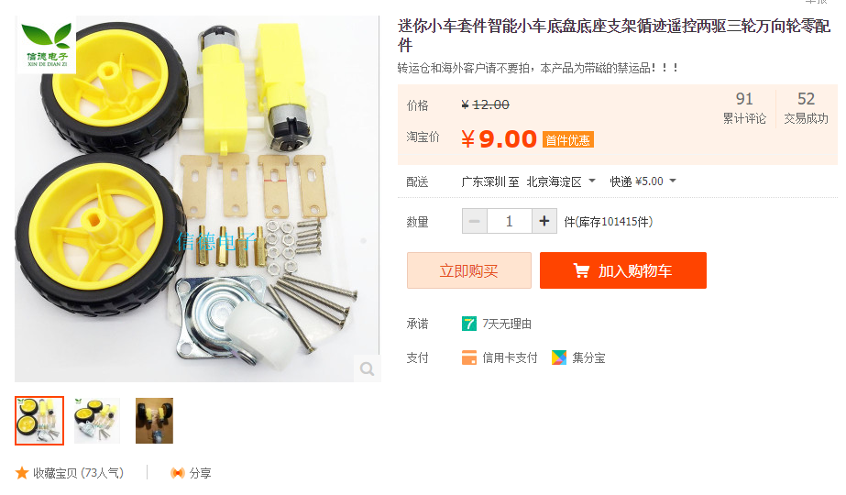

Slide 25
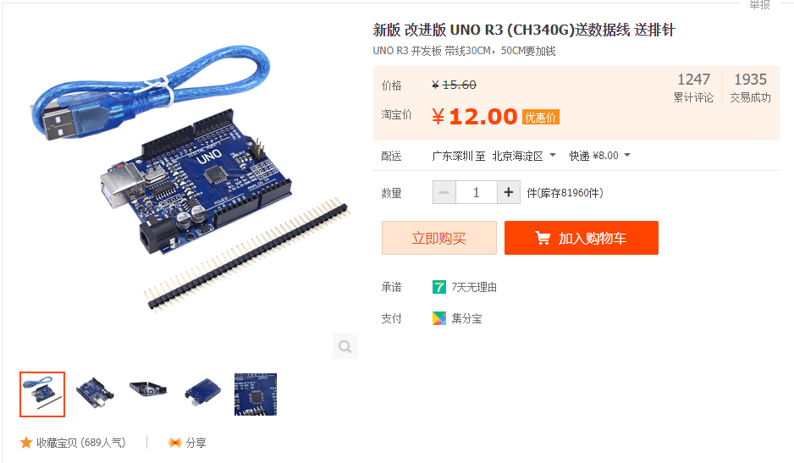

Slide 26
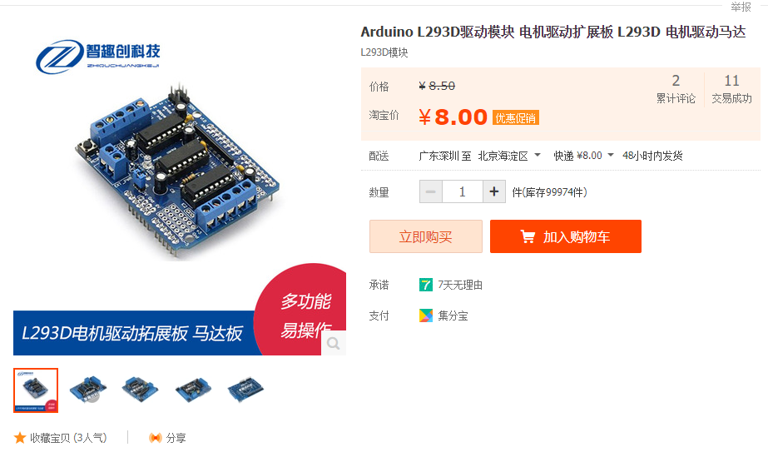

Slide 27
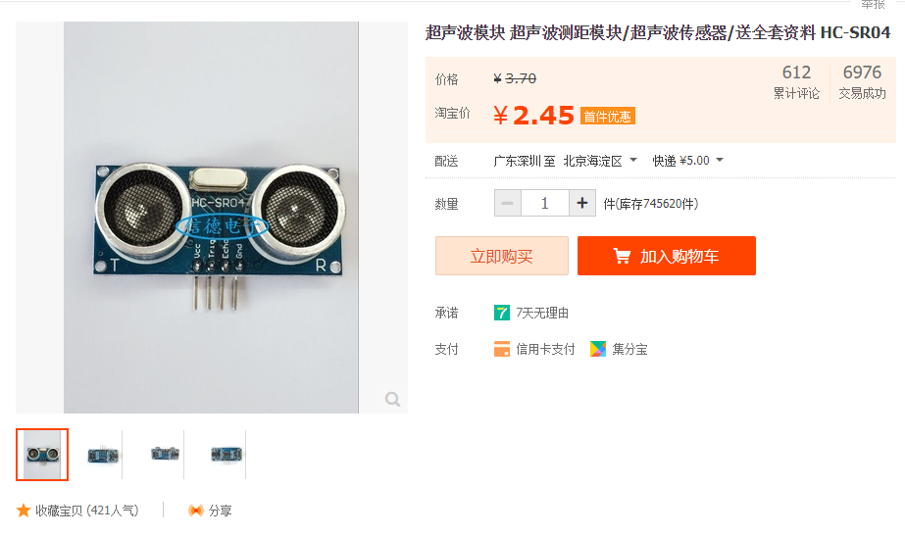

Slide 28
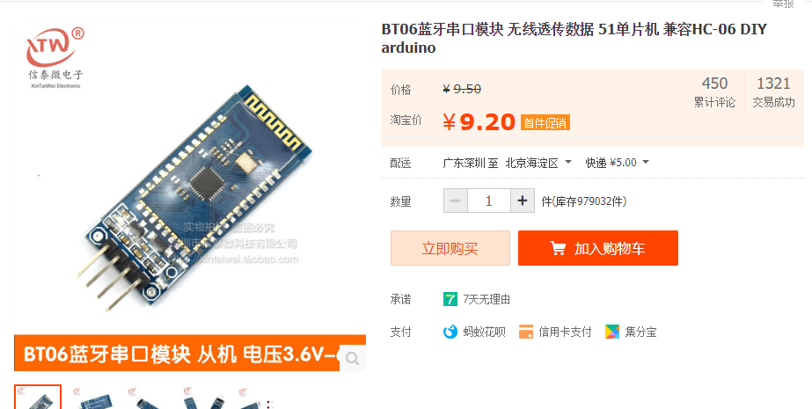

Slide 29
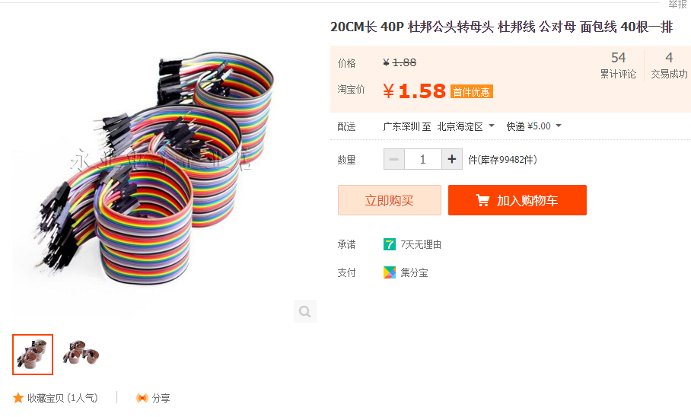

Slide 30
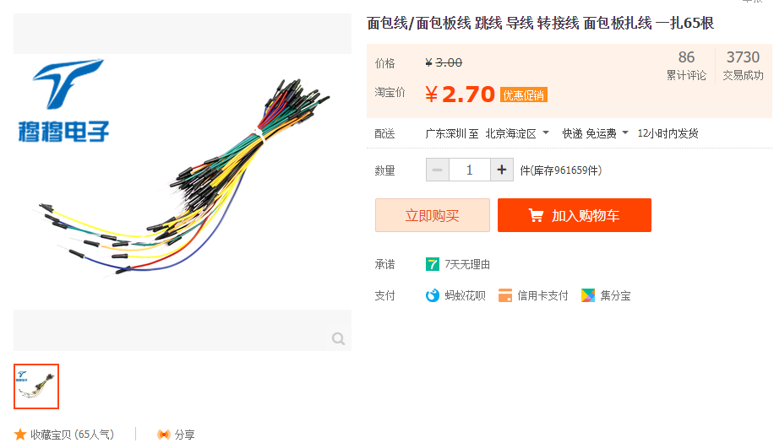

Slide 31


Slide 32
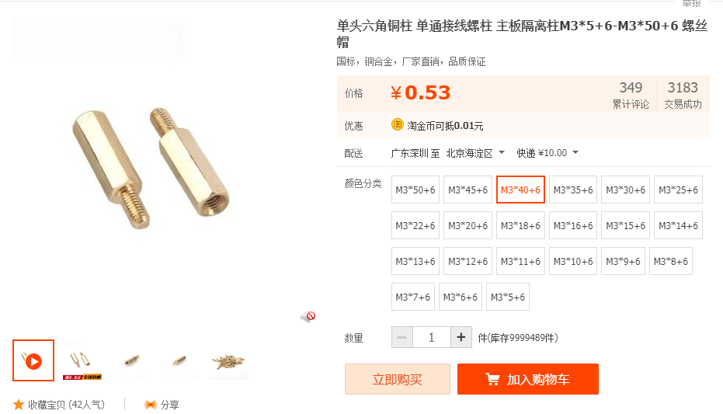

Slide 33

Notes:
power bank (充电宝) is preferred.

Slide 34
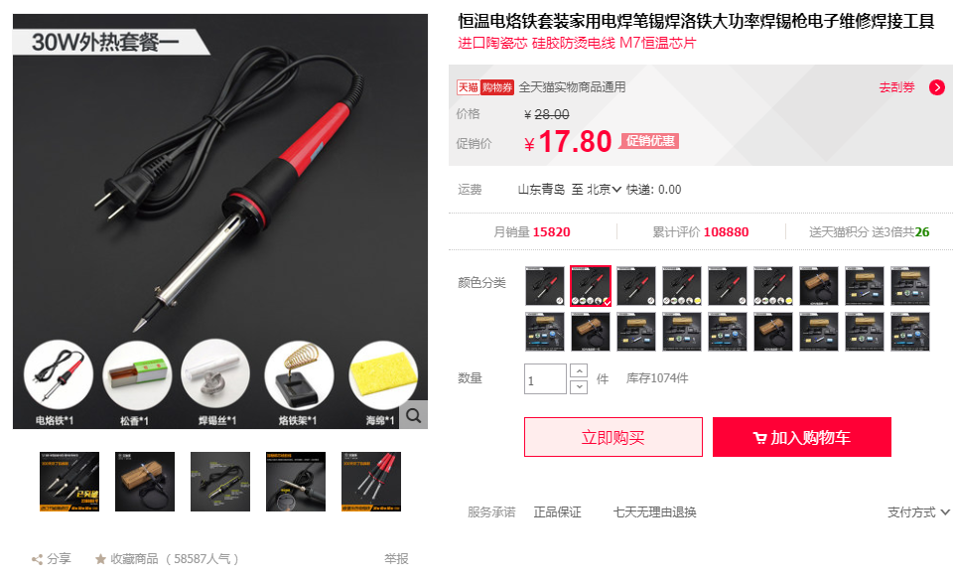

Slide 35
OpenAI Gym
OpenAI Gym is a toolkit for reinforcement learning research. It includes a growing collection of benchmark problems that expose a common interface, and a website where people can share their results and compare the performance of algorithms.

Slide 36
OpenAI Gym
installation
# python 2.7
$ pip install gym
# python 3.5
$ pip3 install gym

Slide 37
OpenAI Gym
import gym
env = gym.make('CartPole-v0')
for i_episode in range(20):
observation = env.reset()
for step in range(100):
env.render()
print(observation)
action = env.action_space.sample()
observation, reward, done, info = env.step(action)
if done:
print("Episode finished after {} timesteps".format(step+1))
break

Slide 38
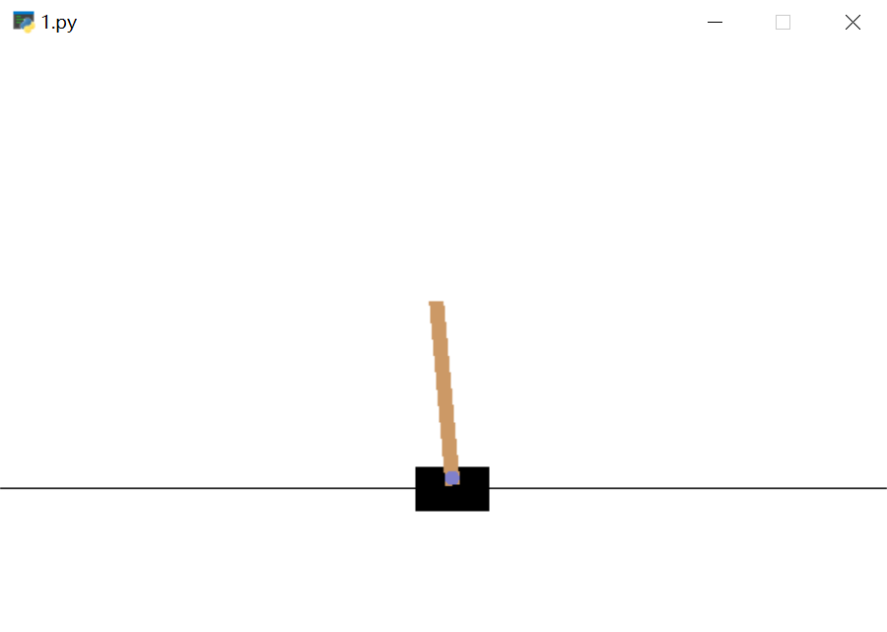
OpenAI Gym

Slide 39
OpenAI Gym
[-0.0132468 -0.00928576 -0.00399978 -0.01440922]
[-0.01343251 -0.20435012 -0.00428797 0.27700905]
[-0.01751952 -0.39941064 0.00125222 0.56833647]
[-0.02550773 -0.59455013 0.01261895 0.86141363]
[-0.03739873 -0.78984163 0.02984722 1.15803742]
[-0.05319556 -0.59512112 0.05300797 0.87486053]
[-0.06509799 -0.79092208 0.07050518 1.18372648]
[-0.08091643 -0.98688436 0.09417971 1.49765098]
[-0.10065412 -1.18301632 0.12413273 1.81819305]
[-0.12431444 -1.37928081 0.16049659 2.14672589]
[-0.15190006 -1.57557986 0.2034311 2.48437392]
Episode finished after 11 timesteps

